Slide 1
Advanced Pattern Mining
P. Krishna Reddy, IIIT Hyderabad

Slide 2
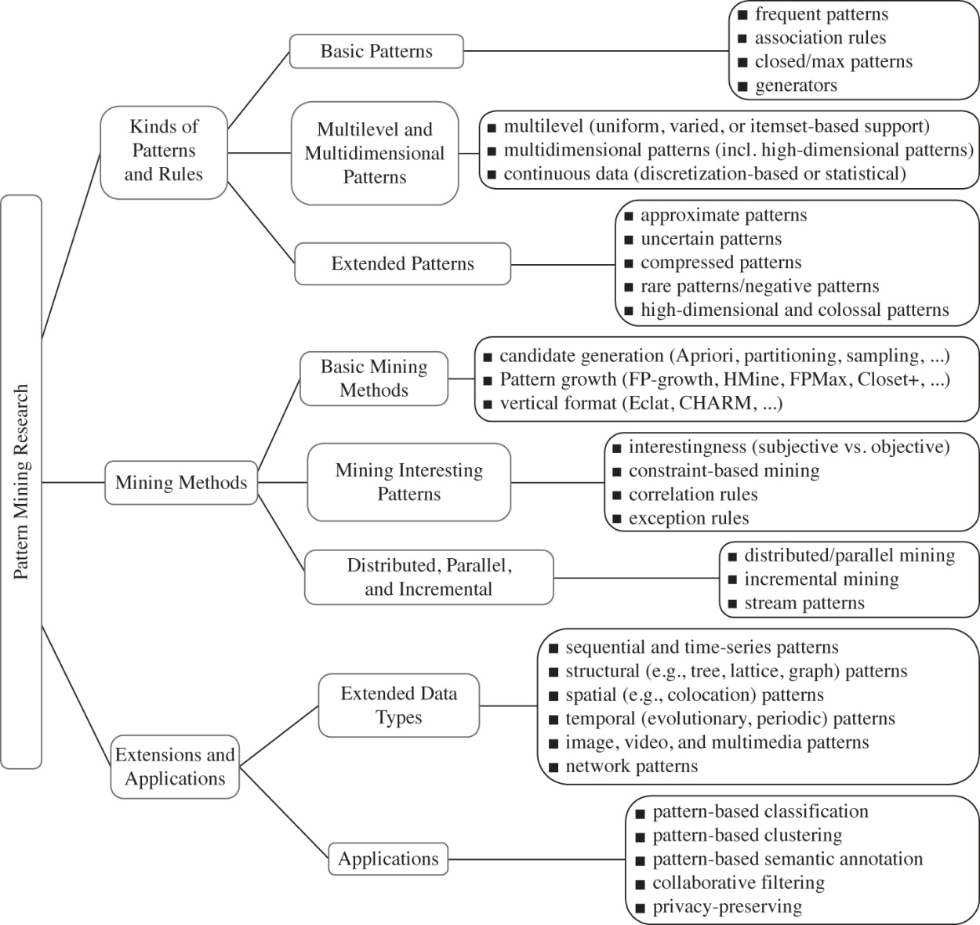
Pattern Mining: A Road Map

Slide 3
Outline
Pattern Mining: A Road Map
Coverage Pattern Mining
Multilevel Pattern Mining
Quantitative Pattern Mining
Multidimensional mining
Diverse Frequent Pattern Mining
High Utility Pattern mining
Mining Rare Patterns and Negative Patterns
Constraint-Based Frequent Pattern Mining
Summary

Slide 4
Discovering Coverage Patterns for Banner Advertisement Placement
P. Gowtham Srinivas, P. Krishna Reddy, S. Bhargav,
R. Uday Kiran, and D. Satheesh Kumar
International Institute of Information Technology
Hyderabad (IIIT-H) , India
Presented by P.Krishna Reddy
E-mail: pkreddy@iiit.ac.in

Slide 5
Outline
Introduction
Coverage patterns
Mining Coverage Patterns
Experimental Results
Conclusions and future work

Slide 6
Introduction
Online advertising is a form of promotion that uses the Internet to deliver marketing messages to attract customers.
provides sustainability for the e-commerce enterprises
a key factor in the growth of internet economy.
There are three modes of online advertising:
Banner Advertising.
hyperlinked to the advertisers primary page or one with more information about the speciﬁc product or service advertised.
Contextual advertising
Relevant advertisements are assigned to a web page based on the content of the web page.
Sponsored search advertising
Advertisements are placed alongside with the search results.

Slide 7
About Banner Advertising
Banner advertising is one of the dominant modes of online advertising.
In this paper, we proposed a notion of coverage patterns to help to place the banner advertisements in a better manner.
Three entities are involved in banner advertising: advertiser, publisher and visitor.
An advertiser is interested in endorsing products through banner advertisements.
A publisher manages a web site or an advertisement network that sells banner advertisement space.
Finally, a visitor visits the web pages of a web site which contains banners.

Slide 8
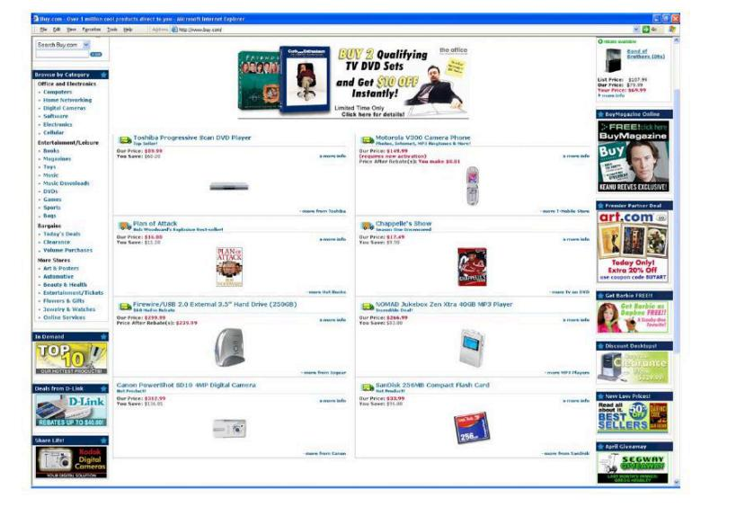
Banner advertisements on www.buy.com

Slide 9
Problem Description
Goal of advertiser
spreading advertisement to a certain percentage of people visiting a web site.
Goal of the publisher
efficiently sell the advertising space available in the web pages of a web site and meeting the demands of multiple advertisers.
Opportunity:
For a given web site and period, one can analyse the visitors’ behaviour by processing the transactions generated based on click stream dataset and identify the sets of web pages that cover a given percentage of visitors’ population.
Research Issue:
Investigate the approaches for discovering the sets of web pages which can cover a given percentage of visitors’ population by analyzing the click stream transactions

Slide 10
Contributions
We have proposed methodology to discover coverage patterns from transactional databases.
Given a set of data items, a coverage pattern is a set of non-overlapping data items covered by a certain percentage of transactions.
An Apriori-like algorithm called CMine is proposed for mining coverage patterns.

Slide 11
Related Work
Coverage patterns
The notion of coverage is being used for solving the set cover problem [2] in set theory and node cover problem [3] in graphs respectively.
In [4], the notion of coverage and overlap is used to examine the creation of a tag cloud for exploring and understanding a set of objects.
In [5], the notion of coverage and overlap is used to solve the problem of topical query decomposition.
Online Advertisement
Most of the research work on online advertisement has been focused on auction models [7], keyword or phrase identification based on user queries [8], contextual advertising [9] and allocation and scheduling of advertisements [10].
To our knowledge, not much amount of research work has been carried out on improving the options offered by the publisher to the advertisers

Slide 12
Advantages
We have proposed a different kind of knowledge patterns.
The proposed patterns can be employed in improving the performance of several applications such as banner advertisements.
help the advertiser by making his advertisement visible to a certain percentage of web site visitors.
Ensuring the publisher to meet the demands of multiple advertisers by considering several groups of potential pages.

Slide 13
Outline
Introduction
Coverage patterns
Mining Coverage Patterns
Experimental Results
Conclusions and future work

Slide 14
Coverage Patterns and Banner Advertisement
We identify the issue of banner advertisement placement as one of the potential application of coverage patterns.
For a given e-commerce web site, transactions generated from click stream dataset can be used to identify the sets of web pages that cover a given percentage of visitors’ population.
We consider transactions generated from click stream data of a web site. However, the model can be extended to any transactional data set.

Slide 15
Basic Terminology
Let W = {w1,w2, · · · , wn} be a set of identifiers of web pages and D be a set of transactions, where each transaction T is a set of web pages such that T ⊆ W.
Associated with each transaction is a unique transactional identifier called TID.
A set of web pages in W i.e., X = {wp, ….. ,wq, wr},
1 ≤ p ≤ q ≤ r ≤ n, is called a pattern.
A pattern containing ‘k’ number of web pages is called a k-pattern. In other words, the length of k-pattern is k.
The percentage of transactions in D that contain the web page wi ∈ W is known as the “relative frequency of a web page wi ∈ W” and denoted as RF(wi).
Let |T^{wi} | indicates the total number of transactions that contain wi. The relative frequency of wi is denoted as RF(wi). That is, RF(wi) = (|T^{wi} |)/|D|.

Slide 16
Proposed Model…
TRANSACTIONAL DATABASE
Table 1.
TID | Web pages | TID | Web pages
1 | a, b, c | 6 | b, d
2 | a, c, e | 7 | b, d
3 | a, c, e | 8 | b, e
4 | a, c, d | 9 | b, e
5 | b, d, f | 10 | a, b
Item | Relative Frequency (RF)
a | 0.5
b | 0.7
c | 0.4
d | 0.4
e | 0.4
f | 0.1
{a, b} is a pattern. Since there are two web pages in this pattern it is a 2-pattern.

Slide 17
Frequent Page
Note that from the advertisement point of view the pages that are visited by more number of users are interesting. We capture this aspect with the notion of frequent page.
The frequent web pages are web pages which have relative frequency no less than the user-speciﬁed threshold value, called minimum relative frequency(minRF) . That is, RF(wi) ≥ minRF.
Example 2: Continuing with the example, the relative frequency of ‘a’ i.e., RF(a) =| T ª |/|D|= 5/10 = 0.5. If the user-speciﬁed minRF = 0.5, then ‘a’ is called a frequent web page because RF(a) ≥ minRF.

Slide 18
Coverage Set
The coverage set is a set of transactions.
Notion: How many users visit at least one web page in the set.
Coverage set of a pattern X = {wp, ….. ,wq, wr}, 1 ≤ p ≤ q ≤ r ≤ n:
The set of distinct TIDs containing at least one web page of X is called the coverage set of pattern X and is denoted as CSet(X). Therefore, CSet(X) = {T^{wp}∪ · · · ∪ T^{wq} ∪ T^{wr} }.
TID | Web pages | TID | Web pages
1 | a, b, c | 6 | b, d
2 | a, c, e | 7 | b, d
3 | a, c, e | 8 | b, e
4 | a, c, d | 9 | b, e
5 | b, d, f | 10 | a, b
Example: The set of tids containing the web page `a' i.e., Tª ={1,2,3,4,10}. Similarly, T^{b}={1,5,6,7,8,9,10}.
The coverage set of {a,b} i.e., CSet({a,b}) ={1,2,3,4,5,6,7,8,9,10} .
Note: In case of frequent patterns, the support of {a,b} ={1,10}=2

Slide 19
Coverage Support
A pattern will be interesting if its coverage set contains more than a threshold number of transactions. This aspect is captured through the notion of coverage support.
Coverage-support of a pattern X : The ratio of size of coverage set of X to the transactional database size is called the coverage-support of pattern X and denoted as CS(X).
CS(X) = |CSet(X)|/ |D|.
For a pattern X, CS(X) ∈ [0, 1].
If CS(X) = 0, no single web page of X has appeared in the entire transactional database.
If CS(X) = 1, every transaction in T contains at least one web page wj ∈ X.
Example: Coverage support of {a,b} i.e., CS({a,b}) = |CSet({a,b})|/|D| = 10/10=1.

Slide 20
Overlap ratio
Adding other web pages in particular web pages co-occurring with any of the web pages belonging to pattern X may not increase the coverage support, significantly.
Due to co-occurrence, there is an overlap of coverage set of X and coverage set of new single web page.
The same users visit the new web page.
Such a pattern can be uninteresting to the advertiser because, the advertisement will be displayed to the same user multiple times.
Example: Tª={1,2,3,4,10}. T^{b}={1,5,6,7,8,9,10}, and T^{c}={1,2,3,4}. CS(a)=0.5, CS(b)=0.7, CS(c)=0.4.
We can note that CS(a,c)=5/10=0.5. However, this pattern is uninteresting as the pattern `c' has not increased coverage-support of the pattern `a'.
We can note that CS(a,b)=1.As compared to {a,c}, the pattern {a,b} is interesting because, the web page `b’ has increased the coverage support of a pattern.

Slide 21
Overlap Ratio
The set of pages will have more coverage support if there is minimum intersection of coverage set of individual pages in the set. We capture this aspect with overlap ratio.
Overlap ratio of a pattern OR(X) : Overlap ratio of a pattern X = {wp, ….. ,wq, wr}, where 1 ≤ p ≤ q ≤ r ≤ n and T^{wp}>=· · · >= T^{wq} >=T^{wr} , is ratio of the number of transactions common in X−{wr} and {wr} to the number of transactions in wr.
OR(X) = |CSet(X−{wr})∩ CSet({wr}) |
CSet({wr})

Slide 22
…Overlap Ratio
For a pattern X, OR(X) ∈ [0, 1]. If OR(X) = 0, there exists no common transactions between X − {wr} and {wr}.
If OR(X) = 1, then wr has occurred in the transactions where at least one web page wj ∈ (X − {wr}) has occurred.
Continuing with the example,
The OR({a,b}) = |CSet(b) ∩ CSet(a)|/|CSet(a)| = 2/5 = 0.4.
Note that a coverage pattern is interesting if it has high coverage support and low overlap ratio.
As a result an advertisement is exposed to more number of users by reducing repetitive display of the advertisement. The deﬁnition of coverage pattern is as follows

Slide 23
Coverage Pattern
Coverage pattern X : A pattern X ={wp, …. , wq, wr}, where 1 ≤ p ≤ q ≤ r ≤ n, is said to be a coverage pattern if CS(x) ≥ minCS and OR(X) ≤ maxOR and RF(wi) ≥ minRF ∀ wi ∈ X.
A coverage pattern X having CS(X) = a% and OR(X) = b% is expressed as
X [CS = a%, OR = b%]
If minRF=0.4, minCS=0.7 and maxOR=0.5, then the pattern {a,b} is a coverage pattern. It is because RF(a) >= minRF, RF(b) >= minRF, CS({a,b}) >= minCS and OR({a,b}) <= maxOR. This pattern is written as follows:
{a,b} [CS=1 (=100%), OR= 0.4 (=40%)]

Slide 24
Problem Statement
Given a transactional database D, set of web pages W and user-specified minimum relatively frequency (minRF), minimum coverage support (minCS) and maximum overlap ratio (maxOR), discover complete set of coverage patterns such that
If X is a coverage 1-pattern (i.e., k = 1), then RF(wi) ≥ minRF, wi ∈ X.
Otherwise (i.e., when k > 1), each coverage pattern X
must have CS(X) ≥ minCS, OR(X) ≤ maxOR and
RF(wi) ≥ minRF, where wi ∈ X.

Slide 25
Outline
Introduction
Coverage patterns
Mining Coverage Patterns
Experimental Results
Conclusions and future work

Slide 26
Extracting Coverage Patterns
Naïve approach
Extract all possible patterns (leads to combinatorial explosion)
Each pattern in CP is added to the coverage pattern set if it satisfies minCS; minRF and maxOR constraints.
Opportunity
The search space can be reduced if the coverage pattern satisfies downward closure property on either coverage support or overlap ratio.

Slide 27
Extracting Coverage Patterns
Coverage support does not satisfy downward closure property. That is, although a pattern satisfies minCS, it is not necessary that all its non-empty subsets will also satisfy minCS value.
Consider the patterns {a}, {e} and {a,e}. The coverage supports of these patterns are 0.5, 0.4 and 0.7, respectively. If the user-specified minCS=0.7, then the pattern {a,e} satisfies minCS value. However, its non-empty subsets do not satisfy minCS value.
The parameter overlap ratio also does not satisfy downward closure property if a pattern is considered as an unordered set of web pages.
The Overlap ratio satisfies downward closure property if a pattern is an ordered set, where web pages are sorted in descending order of their frequencies. This property is known as the sorted closure property.

Slide 28
Extracting Coverage Patterns
If X ⊂ Y, then CSet(X) ⊂= CSet(Y).
Sorted closure property: Let X = {wp, ….. ,wq, wr}, where 1 ≤ p ≤ q ≤ r ≤ n be a pattern such that T^{wp}>=· · · >= T^{wq} >= T^{wr}. If OR(X) <= maxOR, all its non-empty subsets containing wr and having size k>= 2 will also have overlap ratio less than or equal to maxOR.
Rationale: Let wa, wb and wc be the web pages having RF(wa) ≥ RF(wb) ≥ RF(wc). If OR(wa U wc) > maxOR, then OR({wa U wb}U wc) > maxOR because from above property
|CSet(w_{a}) ∩ CSet(w_{c})| / |CSet(w_{c})| <= CSet({w_{a} U w_{b}}) ∩ CSet(w_{c})/CSet(w_{c}).
(Non-overlap pattern X.) A pattern X is said to be non-overlap if OR(X) ≤ maxOR and RF(wi) ≥ minRF ∀ wi ∈ X.

Slide 29
Extracting Coverage Patterns
Every coverage pattern is a non-overlap pattern
However, every non-overlap pattern may not be a coverage pattern.
The sorted closure property of non-overlap patterns is used for minimizing the search space while mining complete set of coverage patterns by designing an algorithm similar to the Apriori algorithm .

Slide 30
Proposed Algorithm
The proposed algorithm CMine employs level-wise search to discover the complete set of coverage patterns.
In level-wise search, k-patterns are used to explore (k + 1)-patterns.
Notations
F | Set of Frequent items
Ck | Set of Candidate K-patterns
Lk | Set of Coverage K-patterns
NOk | Set of non-overlap K-patterns

Slide 31
CMine Algorithm
Step 1: In the first scan of the database, CMine discovers set of all frequent items (denoted as F) and coverage 1-patterns (denoted as L1). Next, items in NO1 are sorted in descending order of their frequencies.
Step 2: Using NO1 as a seed set, candidate patterns C2 are generated.
Step 3: From C2, the patterns that satisfy minCS and maxOR are generated as coverage 2-patterns, L2.
Simultaneously, all candidate 2-patterns that satisfy maxOR are generated as non-overlap 2-patterns NO2.
Step 4 : C3 is generated by combining NO2 NO2.
Step 5 : From C3, L3 and NO3 are discovered.
The above process is repeated until no new coverage pattern is found, or no new candidate pattern can be generated.

Slide 32
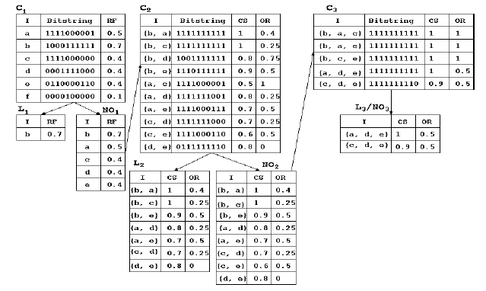
CMine Algorithm Example
Note:
(i){b,a} will be joined with
{b,c} and forms a pattern {b,a,c}
as RF(a) > RF(c).
(ii) {b,c} can not be joined with
{b,a} to form a pattern {b,c,a}
as RF(c) < RF(a).
minRF = 0.4, minCS = 0.7, maxOR = 0.5 for database given in Table 1.

Slide 33
Outline
Introduction
Coverage patterns
Mining Coverage Patterns
Experimental Results
Conclusions and future work

Slide 34
Experimental Results
For experimental purposes we have chosen two kinds of datasets: (i)real world dataset and (ii)synthetic-dataset.
The four real world datasets considered for the experiments are described below.
Kosarak dataset is a sparse dataset with 9,90,002 number of transactions containing 41,270 distinct items.
MSNBC dataset contains data from Internet Information Server (IIS) logs for msnbc.com and news-related portions of msn.com for the entire day of September, 28, 1999 . Requests are at the level of page category. The number of categories are 17 and the number of transactions are 989,818
Mushroom dataset is a dense dataset containing 8,124 transactions and 119 distinct items.
BMS-POS dataset contains click stream data of a dotcom company . The dataset contains 515,597 number of transactions and 1656 distinct items.
The synthetic dataset T40I10D100K dataset which is generated by the dataset generator [9]. The dataset contains 100000 transactions and 941 distinct items.
The CMine algorithm was written in Java and run with Windows XP on a 2.66 GHz machine with 2GB memory.

Slide 35
Usefulness of coverage patterns
The names of web page categories involved in MSNBC are
“frontpage”, “news”, “tech”, “local”, “opinion”, “on-air”, “misc”, “weather”, “health”, “living”, “business”, “sports”, “summary”, “bbs” (bulletin board service), “travel”, “msn-news”, and “msn-sports”.
S.No | Coverage Pattern | CS
1 | {local, misc, front page} | 0.42
2 | {news, health, front page} | 0.43
3 | {tech, opinion, front page} | 0.41
4 | {on-air, news, misc} | 0.40
5 | {tech, weather, on-air} | 0.41
6 | {sports, misc, opinion} | 0.43
Advantage:
Proposed approach provides ﬂexibility to the publisher to meet the demands of multiple advertisers by considering different sets of web pages.

Slide 36
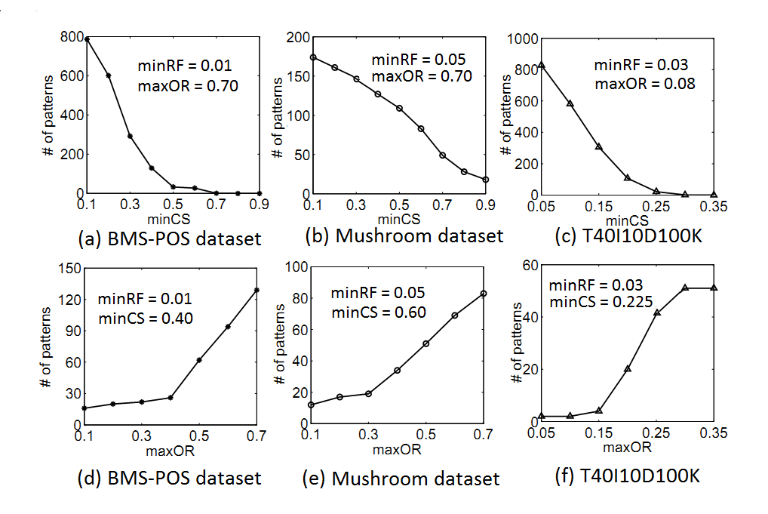
Coverage pattern generation

Slide 37
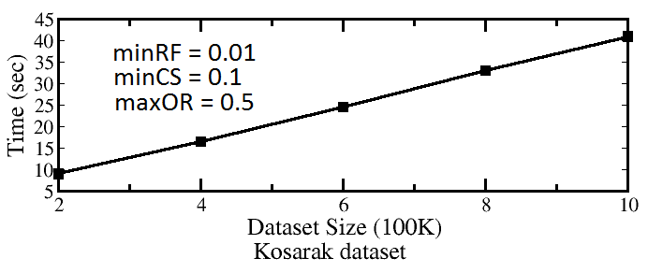
Scalability of CMine Algorithm
Fig 4. Scalability of CMine algorithm

Slide 38
Conclusions and Future Work
Proposed a framework of data mining pattern called “coverage pattern”
Proposed a methodology to extract the same from transactional databases.
Through experimental results, we have shown that the proposed model and methodology can effectively discover coverage patterns.
The coverage patterns help the publisher to meet the demands of multiple advertisers.

Slide 39
Conclusions and Future Work
We are going to investigate how both frequent and coverage pattern knowledge can be used for efﬁcient banner advertisement placement.
How the content of the web page and search query can be exploited to explore content speciﬁc coverage patterns.
The notion of coverage patterns can be extended to other domains like bio-informatics for extracting potential knowledge patterns.

Slide 40
MIDSEM: TILL THE PRECEDING SLIDE.

Slide 41
Outline
Pattern Mining: A Road Map
Coverage Pattern Mining
Multilevel Pattern Mining
Quantitative Pattern Mining
Mining Multidimensional Associations
Diverse Frequent Pattern Mining
High Utility Pattern mining
Mining Rare Patterns and Negative Patterns
Constraint-Based Frequent Pattern Mining
Summary

Slide 42
About Multilevel Pattern Mining
Applications require association rules at many levels of abstraction
“80 percent of customers that purchase milk may also purchase Bread”
“75 percent of people buy wheat bread if they buy “milk(2%)”
The association relationship in the latter statement is expressed at a lower level of abstraction but carries more specific and concrete information than that in the former.
Therefore, a data mining system should provide efficient methods for mining multiple-level association rules.

Slide 43
Why Multiple-Level Association Rules?
Frequent itemset: {b2}
TID | items
T1 | {m1, b2}
T2 | {m2, b1}
T3 | {b2}
Association rules: none
Is this database useless?

Slide 44
Why Multiple-Level Association Rules?
What if we have this abstraction tree?
food
TID | items
T1 | {milk, bread}
T2 | {milk, bread}
T3 | {bread}
milk
bread
m1
m2
b1
b2
minisup = 50% miniconf = 50%
Frequent itemset: {milk, bread}
A.A rules: milk <=> bread

Slide 45
Why Multiple-Level Association Rules?
Sometimes, at primitive data level, data does not show
any significant pattern. But there are useful information
hiding behind.
The goal of Multiple-Level Association Analysis is
to find the hidden information in or between levels
of abstraction

Slide 46
Input
Input to Multi-Level Association Rule Mining
1) data at multiple levels of abstraction, and
2) efficient methods for multiple-level rule mining.
The first requirement can be satisfied by providing concept taxonomies from the primitive level concepts to higher levels.
In many applications, the taxonomy information is either
stored implicitly in the database
provided by experts or users,
or computed by applying some cluster analysis methods
We assume that concept taxonomies exist.

Slide 47
Requirements in Multiple-Level Association Analysis
Two general requirements to do multiple-level association rule mining:
1) Provide data at multiple levels of abstraction. (a common practice now)
2) Find efficient methods for multiple-level rule mining.

Slide 48
Observation
One choice
Direct application of the existing single-level association rule mining methods to multiple-level association mining.
For example, one may apply the Apriori algorithm to examine data items at multiple levels of abstraction under the same minimum support and minimum confidence thresholds.
Apriori with single minimum support and minimum confidence may lead to some undesirable results.

Slide 49
Observation..
Undesirable results with apriori
First, large support is more likely to exist at high levels of abstraction.
If one wants to find strong associations at relatively low levels of abstraction, the minimum support threshold must be reduced substantially, which may lead to the generation of many uninteresting associations at high or intermediate levels.
Second, since it is unlikely to find many strong association rules at a primitive concept level, mining strong associations should be performed at a rather high concept level. But, rules at high concept levels,
may often lead to the rules corresponding to prior knowledge and expectations, such as “milk->bread”, (which could be common sense),
or lead to some uninteresting attribute combinations if the minimum support is allowed to be rather small, such as “toy -> milk”,

Slide 50
Algorithm : observation
Frequent itemset: {milk, bread}
A rule: milk <=> bread
TID | items
T1 | {milk, bread}
T2 | {milk, bread}
T3 | {bread}
T4 | {milk, bread}
T5 | {milk}
food
Level 1
milk
bread
What about {m2, b1}?
TID | items
T1 | {m1, b2}
T2 | {m2, b1}
T3 | {b2}
T4 | {m2, b1}
T5 | {m2}
m1
m2
b1
b2
Level 2
One minisup for
all levels?
Frequent itemset: {m2}
A rule: none
minisup = 50% miniconf = 50%

Slide 51
Algorithm : observation
Frequent itemset: {milk, bread}
A rule: milk <=> bread
food
Level 1: minisup = 50%
milk
bread
Level 2: minisup = 40%
makes more sense now
m1
m2
b1
b2
miniconf = 50%
Frequent itemset: { m2, b1, b2}
A rule: m2 <=> b1

Slide 52
Algorithm: observation
Drawbacks to use only one minisup:
If the minisup is too high, we are losing information from lower levels
If the minisup is too low, we are gaining too many rules from higher levels, many of them are useless
food
Approach: ascending minisup
on each level
milk
bread
m1
m2
b1
b2
minisup

Slide 53
Research Paper: Mining Multiple-level Association Rules in Large Databases
IEEE Transactions on Knowledge and
Data Engineering, 1999
JIAWEI HAN and YONGJIAN FU

Slide 54
Multi-level Association Rules

Slide 55
Multi-level Association Rules..
The definition 2.2
patterns to be examined at lower levels to be only those with large supports at their corresponding high levels (and thus avoids the generation of many meaningless combinations formed by the descendants of the infrequent patterns).
For example, in a sales transaction data set,
if milk is a frequent pattern, its lower level patterns, such as 2 percent milk, will be examined;
whereas if fish is an infrequent pattern, its descendants, such as salmon, will not be examined further.

Slide 56
About the Method
Used hierarchy information encoded transaction table
Collect task relevant data and mine
Encoding can be done during the collection

Slide 57
Encoding Method
Purpose: To find multiple-level frequent item sets for mining strong association rules in a transaction database
Input
T[1]: a hierarchy-information encoded transaction table of form <TID,Item-set>
minisup threshold for each level L in the form: (minsup[L])
Output: Multiple-level frequent item sets
Method: A top-down, progressively deepening process which collects frequent item sets at different concept levels as follows.

Slide 58
Algorithm: An Example
An entry of sales_transaction Table
Transaction_id | Bar_code_set
351428 | {17325,92108,55349,88157,…}
A sales_item Description Relation
Bar_code | category | Brand | Content | Size | Storage_pd | price
17325 | Milk | Foremost | 2% | 1ga. | 14(days) | $3.89
Example 2.1. Let the query be to find multiple-level strong associations in the database in Table 1 for the purchase patterns related to category, content, and brand of the foods which can only be stored for less than three weeks.

Slide 59
Algorithm: An Example
Encode the database with layer information
GID | bar_code | category | content | brand
112 | 17325 | Milk | 2% | Foremost
food
First 1: implies milk
bread
milk
Second 1: implies 2% content
2%
chocolate
white
wheat
2: implies Foremost brand
Dairyland
Foremost

Slide 60
Encoded Transaction Table:T[1]
Algorithm: An Example
TID | Items
T1 | {111,121,211,221}
T2 | {111,211,222,323}
T3 | {112,122,221,411}
T4 | {111,121}
T5 | {111,122,211,221,413}
T6 | {211,323,524}
T7 | {323,411,524,713}

Slide 61
T[2]
Algorithm: An Example
The frequent 1-itemset on level 1
Level-1 minsup = 4
L[1,1]
Itemset | Support
{1**} | 5
{2**} | 5
only keep items
in L[1,1] from T[1]
TID | Items
T1 | {111,121,211,221}
T2 | {111,211,222}
T3 | {112,122,221}
T4 | {111,121}
T5 | {111,122,211,221}
T6 | {211}
L[1,2]
Itemset | Support
{1**,2**} | 4
Use Apriori on each level

Slide 62
Algorithm: An Example
L[2,2]
Level-2 minsup = 3
Itemset | Support
{11*,12*} | 4
{11*,21*} | 3
{11*,22*} | 4
{12*,22*} | 3
{21*,22*} | 3
L[2,1]
Itemset | Support
{11*} | 5
{12*} | 4
{21*} | 4
{22*} | 4
L[2,3]
Itemset | Support
{11*,12*,22*} | 3
{11*,21*,22*} | 3

Slide 63
Frequent Item Sets at Level 3
Level-3 minsup = 3
L[3,1]
L[3,2]
Itemset | Support
{111} | 4
{211} | 4
{221} | 3
Itemset | Support
{111,211} | 3
Only generate T[1] & T[2], all frequent itemsets
after level 2 is generated from T[2]
E.g.
Level-1:
80% of customers that purchase milk also purchase bread.
milk ➔ bread with Confidence= 80%
Level-2:
75% of people who buy 2% milk also buy wheat bread.
2% milk ➔ wheat bread with Confidence= 75%

Slide 64
Multi-level Association: Flexible Support and Redundancy filtering
Flexible min-support thresholds: Some items are more valuable but less frequent
Use non-uniform, group-based min-support
E.g., {diamond, watch, camera}: 0.05%; {bread, milk}: 5%; …
Redundancy Filtering: Some rules may be redundant due to “ancestor” relationships between items
milk ⇒ wheat bread [support = 8%, confidence = 70%]
2% milk ⇒ wheat bread [support = 2%, confidence = 72%]
The first rule is an ancestor of the second rule
A rule is redundant if its support is close to the “expected” value, based on the rule’s ancestor

Slide 65
Outline
Pattern Mining: A Road Map
Coverage Pattern Mining
Multilevel Pattern Mining
Quantitative Pattern Mining
Diverse Frequent Pattern Mining
High Utility Pattern mining
Mining Rare Patterns and Negative Patterns
Constraint-Based Frequent Pattern Mining
Summary

Slide 66
Boolean Association Rules
The table has an attribute correspond to each item. A record correspond to each transaction.
Value of attribute is “1” if it exists on record.
All the attributes are Boolean.

Slide 67
Boolean Association Rules
TID | A | B | C | D | E
1 | 1 | 0 | 1 | 1 | 0
2 | 0 | 1 | 1 | 0 | 1
3 | 1 | 1 | 1 | 0 | 1
4 | 0 | 1 | 0 | 0 | 1
5 | 1 | 1 | 1 | 0 | 1
Attribute has a value of “1” if the transaction contains the corresponding item; “0” otherwise.

Slide 68
Large Relational Tables in real-life.
Relational tables in most business and scientific domains have richer attribute types.
Quantitative attributes (e.g. age, income)
Categorical attributes (e.g. zip code, marriage status, make of car)
Can not apply existing methods to extract Boolean association rules to mine association rules over quantitative and categorical attributes.
This paper present techniques for discovering such rules.

Slide 69
Quantitative Association Rules: Example

Slide 70
Mapping to Boolean Association Rules Problem
Using <attribute: value> as new attribute, which has only Boolean values
Categorical: The value of Boolean field corresponding to <attribute1, value1> would be “1”, if atribute1 had value 1 in the original record, and “0” otherwise.
If the domain of values is large, partition the values into intervals and map each pair to Boolean attribute.
Use any exiting algorithm a priori or FP Tree.
RecordID | Age: 20..29 | Age: 30..39 | Married: Yes | Married: No | NumCars: 0 | NumCars: 1
100 | 1 | 0 | 0 | 1 | 0 | 1
200 | 1 | 0 | 1 | 0 | 0 | 1
300 | 1 | 0 | 0 | 1 | 1 | 0
400 | 0 | 1 | 1 | 0 | 0 | 0
500 | 0 | 1 | 1 | 0 | 0 | 0

Slide 71
First Problem with Direct Mapping
MinSup: If the number of intervals for a quantitative attribute is large, the support for any single interval can be low. Some rules involving this attribute may not be found because they lack minimum support.

Slide 72
Second Problem with Direct Mapping
.
MinConf. There is some information lost whenever we partition values into intervals. This information loss increases as the interval sizes become larger.

Slide 73
Example “MinConf” problem.
The rule
< NumCars: 0> => <Married: No> has 100% confidence.

Slide 74
Example “MinConf” problem. (con’t)
Closest rule is
<NumCars: 0..1> => <Married: No>
has only 66.66% confidence.

Slide 75
“catch-22” Situation.
Mapping problems create “catch-22” situation.
If the intervals are too large, some rules may not have minimum confidence.
If the intervals are too small, some rules may not have minimum support.

Slide 76
Mining Quantitative Associations
Techniques can be categorized by how numerical attributes, such as age or salary are treated
Static discretization based on predefined concept hierarchies (data cube methods)
Dynamic discretization based on data distribution (quantitative rules, e.g., Agrawal & Srikant@SIGMOD96)
Clustering: Distance-based association (e.g., Yang & Miller@SIGMOD97)
One dimensional clustering then association
Deviation: (such as Aumann and Lindell@KDD99)
Sex = female => Wage: mean=$7/hr (overall mean = $9)

Slide 77
Mining Multi-Dimensional Association
Single-dimensional rules:
buys(X, “milk”) ⇒ buys(X, “bread”)
Multi-dimensional rules: ≥ 2 dimensions or predicates
Inter-dimension assoc. rules (no repeated predicates)
age(X,”19-25”) ∧ occupation(X,“student”) ⇒ buys(X, “coke”)
hybrid-dimension assoc. rules (repeated predicates)
age(X,”19-25”) ∧ buys(X, “popcorn”) ⇒ buys(X, “coke”)
Categorical Attributes: finite number of possible values, no ordering among values—data cube approach
Quantitative Attributes: Numeric, implicit ordering among values—discretization, clustering, and gradient approaches

Slide 78
Outline
Pattern Mining: A Road Map
Coverage Pattern Mining
Multilevel Pattern Mining
Quantitative Pattern Mining
Diverse Frequent Pattern Mining
High Utility Pattern mining
Mining Rare Patterns and Negative Patterns
Constraint-Based Frequent Pattern Mining
Summary

Slide 79
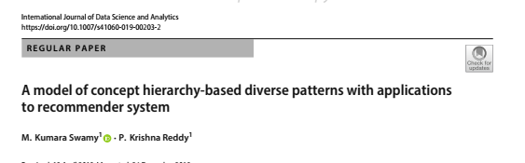
Model of Diverse Frequent Patterns

Slide 80
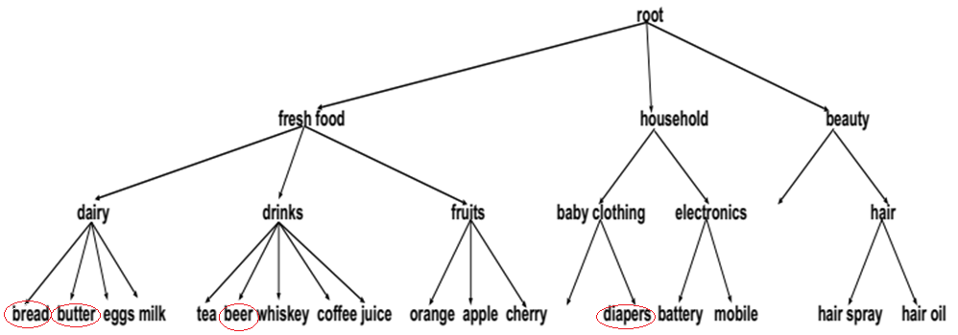
Notion of Diversity
Consider patterns, {bread, butter} and {beer, diaper} with the same support
Normally {beer, diaper} is more interesting than {bread, butter}
Reason
The items bread and butter are belong to same category Dairy (Food Product)
The items beer and diaper belong to different categories drinks and baby clothing
We say that {beer, diaper} is more diverse than {bread, butter}

Slide 81
Notion of Diversity …
For certain types of applications, it may be useful to distinguish between the pattern with items belonging to different categories and the pattern with items belonging to few categories.
The existing pattern extraction approaches (frequent, sequential, periodic, etc.) fail to make such distinction.
It is possible to rank the patterns by analysing the extent to which the items in the patterns belong to different categories.

Slide 82
About Computation of Diversity
A pattern is an itemset (set of items)
The diversity value of a pattern is called diverse rank (drank)
To compute the drank of a pattern, the following issues are to be resolved
To determine the category of items, category level relationship among the items is needed
We employ concept hierarchy to find the relationship of the items at higher level categories
Given a concept hierarchy, a framework is required to compute the drank value of the pattern
Given a set of items, concept hierarchy, and transactional database, an approach has to be developed to extract diverse patterns and diverse frequent patterns

Slide 83
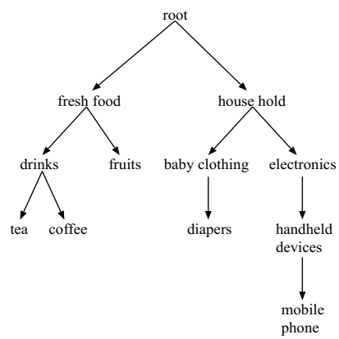
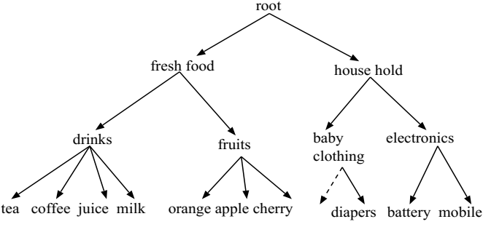
About Balanced and Unbalanced Concept Hierarchy
Balanced concept hierarchy
The depth of all leaf-level items are equal
Unbalanced concept hierarchy
The depth of all leaf-level items are not equal

Slide 84
Model of Diverse Pattern
The diversity of a pattern measures the extent of the items belong to multiple higher level categories.
The items of a pattern are mapped to the same/few categories in a concept hierarchy, the pattern has low diversity
Relatively, the items of a pattern are mapped to multiple categories, the pattern has more diversity
Merging behavior: The speed of mapping of items from low level items to high level categories
The question: how to measure the merging behavior?
The pattern merges into one/few higher level categories quickly, and ultimately all paths join at the root, the pattern has low diversity value
The pattern merges directly at root slowly by crossing several intermediary categories, it has relatively high diversity values

Slide 85
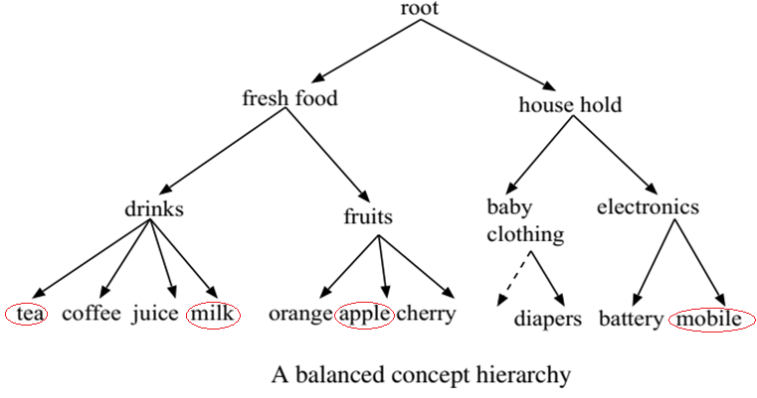
Model of Diverse of Pattern …
Example
Consider the patterns {tea, milk}, {milk, apple} and {milk, mobile}
The pattern {tea, milk} quickly merges to parent, the diversity of the pattern is low.
The pattern {milk, apple} merges slowly as compared to the pattern {tea, milk}, the diversity of the pattern is medium.
Similarly, the pattern {milk, mobile} merges slowly at root crossing several internal nodes,
the diversity of the pattern is high

Slide 86
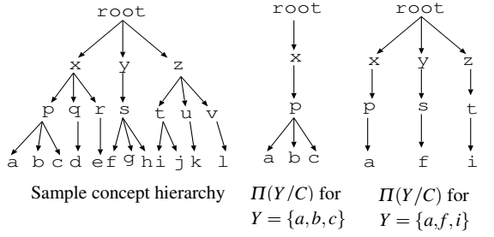
Computing the Diversity of a Pattern
Terminology
Balanced patterns (BP): Let I = {i₁,i₂··· , i_{n} } be a set of items, D be a transactional database on I, and C be a concept hierarchy of I with height h. A pattern Y = {i₁,i₂··· , i_{m}} ⊆ I with m items is called balanced pattern, if the height of all the items in Y is equal to h.
Projection of Pattern (Y) on concept hierarchy (C): It is denoted by π(Y/C). It is a sub-tree which contains the portion of C concerning to the pattern Y. All the nodes and edges exist in the paths of the items of Y to the root.

Slide 87
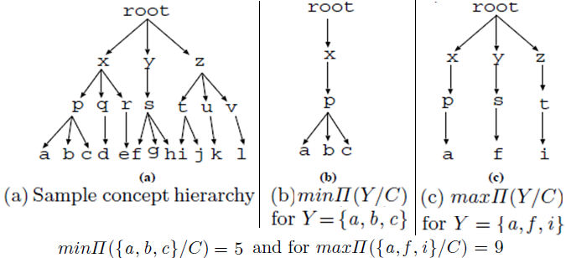
Framework to Compute drank using
Balanced Concept Hierarchy
Given the pattern Y of certain size and concept hierarchy C, two extreme projections are possible
Minimal projection
All the items of Y merge at immediate higher level
The number of edges |min π(Y/C)| is equal to (|Y| + h – 1)
Maximal projection
All the leaf level nodes merges at root.
The number of edges |max π(Y/C)|
is equal to (|Y| x h )
Observation: Given a pattern Y of certain size
Its minimal projection contains minimum
number of edges and maximal project
contains the maximum number of edges

Slide 88




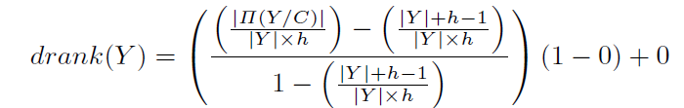
Framework to Compute drank using
Balanced Concept Hierarchy …
Given a pattern Y, the drank(Y) is the ratio of number of edges in its projection (π(Y/C)) and the maximal projection (max π(Y/C)) which is equal to
The minimum value of this ratio is equal to which is equal to 0.
The maximum value of this ratio is equal to which is equal to 1.
On applying the min-max normalization, we get following formula.

Slide 89
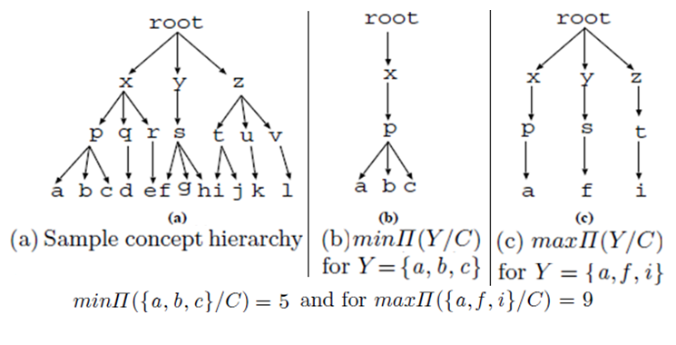
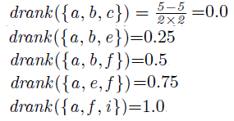
Example

Slide 90


Slide 91
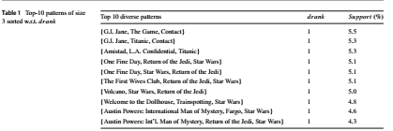
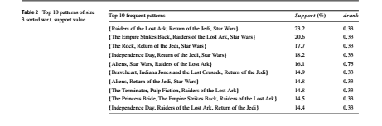
Experiments
Dataset from MovieLens project (http://www.grouplens.org) : contains 100,000 ratings of 943 users on 1682 movies

Slide 92
Outline
Pattern Mining: A Road Map
Coverage Pattern Mining
Multilevel Pattern Mining
Quantitative Pattern Mining
Diverse Frequent Pattern Mining
High Utility Pattern mining
Mining Rare Patterns and Negative Patterns
Constraint-Based Frequent Pattern Mining
Summary

Slide 93
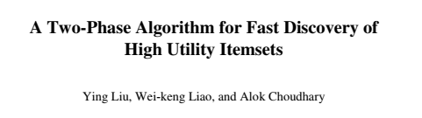
HIGH UTILITY MINING
PAKDD 2005

Slide 94
Limitations of Frequent Itemset Mining
Purchase quantities are not taken into account.
Thus, an item may only appear once or zero time in a transaction. Thus, if a customer has bought five breads, ten breads or twenty breads, it is viewed as the same.
All items are viewed as having the same importance, utility of weight.
For example, if a customer buys a very expensive bottle of wine or just a piece of bread, it is viewed as being equally important.
Frequent pattern mining may find many frequent patterns that are not interesting.
For example, one may find that {bread, milk} is a frequent pattern. However, from a business perspective, this pattern may be uninteresting because it does not generate much profit.
Moreover, frequent pattern mining algorithms may miss the rare patterns that generate a high profit such as perhaps {caviar, wine}

Slide 95
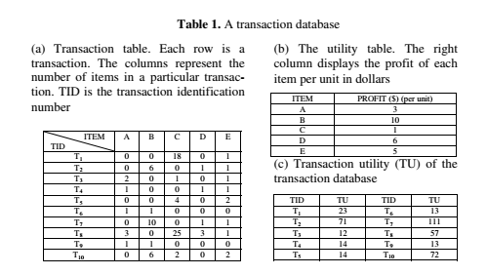
High-utility itemset mining
High-utility itemset mining addresses the limitations .
A transaction database contains transactions where purchase quantities are taken into account as well as the unit profit of each item. For example, consider the following transaction database.
Local transaction utility of an item
External utility of an item
Utility of the item in a transaction= Local utility * external utility

Slide 96
Two-Phase algorithm
Transaction utility= sum of all utilities of items
Transaction weighted utility of itemset X, twu(X)= Summation of utilities all transactions Ti such that X is belongs to Ti.
High Transaction-weighted Utilization Itemset: Tranasaction weighted Utility of the itemset should be greater than the user given threshold.
Transaction-weighted Downward Closure Property: If k-itemset is high transaction-weighted utilization itemset, k-1 itemset will be high transaction-weighted utilization itemset.
Theorem: Let HTWU be the collection of all high transaction-weighted utilization itemsets in a transaction database D, and HU be the collection of high utility itemsets in D. Then HU is the subset of HTWU.

Slide 97
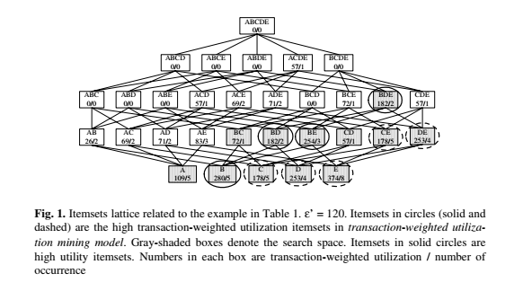

Slide 98
Outline
Pattern Mining: A Road Map
Coverage Pattern Mining
Multilevel Pattern Mining
Quantitative Pattern Mining
Diverse Frequent Pattern Mining
High Utility Pattern mining
Mining Rare Patterns and Negative Patterns
Constraint-Based Frequent Pattern Mining
Summary

Slide 99
Negative and Rare Patterns
Rare patterns: Very low support but interesting
E.g., buying Rolex watches
Mining: Setting individual-based or special group-based support threshold for valuable items
Negative patterns
Since it is unlikely that one buys Ford Expedition (an SUV car) and Toyota Prius (a hybrid car) together, Ford Expedition and Toyota Prius are likely negatively correlated patterns
Negatively correlated patterns that are infrequent tend to be more interesting than those that are frequent

Slide 100
Defining Negative Correlated Patterns (I)
Definition 1 (support-based)
If itemsets X and Y are both frequent but rarely occur together, i.e.,
sup(X U Y) < sup (X) * sup(Y)
Then X and Y are negatively correlated
Problem: A store sold two needle 100 packages A and B, only one transaction containing both A and B.
When there are in total 200 transactions, we have
s(A U B) = 0.005, s(A) * s(B) = 0.25, s(A U B) < s(A) * s(B)
When there are 10⁵ transactions, we have
s(A U B) = 1/10⁵, s(A) * s(B) = 1/10^{3 *} 1/10³, s(A U B) > s(A) * s(B)
Where is the problem? —Null transactions, i.e., the support-based definition is not null-invariant!
100
Notes:
100

Slide 101
Defining Negative Correlated Patterns (II)
Definition 2 (negative itemset-based)
X is a negative itemset if (1) X = Ā U B, where B is a set of positive items, and Ā is a set of negative items, |Ā|≥ 1, and (2) s(X) ≥ μ
Itemsets X is negatively correlated, if
This definition suffers a similar null-invariant problem
Definition 3 (Kulzynski measure-based) If itemsets X and Y are frequent, but (P(X|Y) + P(Y|X))/2 < є, where є is a negative pattern threshold, then X and Y are negatively correlated.
Ex. For the same needle package problem, when no matter there are 200 or 10⁵ transactions, if є = 0.01, we have
(P(A|B) + P(B|A))/2 = (0.01 + 0.01)/2 < є
101
Notes:
101

Slide 102
Outline
Pattern Mining: A Road Map
Coverage Pattern Mining
Multilevel Pattern Mining
Quantitative Pattern Mining
Diverse Frequent Pattern Mining
High Utility Pattern mining
Mining Rare Patterns and Negative Patterns
Constraint-Based Frequent Pattern Mining
Summary

Slide 103
Constraint-based (Query-Directed) Mining
Finding all the patterns in a database autonomously? — unrealistic!
The patterns could be too many but not focused!
Data mining should be an interactive process
User directs what to be mined using a data mining query language (or a graphical user interface)
Constraint-based mining
User flexibility: provides constraints on what to be mined
Optimization: explores such constraints for efficient mining — constraint-based mining: constraint-pushing, similar to push selection first in DB query processing
Note: still find all the answers satisfying constraints, not finding some answers in “heuristic search”

Slide 104
Constraints in Data Mining
Knowledge type constraint:
classification, association, etc.
Data constraint — using SQL-like queries
find product pairs sold together in stores in Chicago this year
Dimension/level constraint
in relevance to region, price, brand, customer category
Rule (or pattern) constraint
small sales (price < $10) triggers big sales (sum > $200)
Interestingness constraint
strong rules: min_support ≥ 3%, min_confidence ≥ 60%

Slide 105
Meta-Rule Guided Mining
Meta-rule can be in the rule form with partially instantiated predicates and constants
P₁(X, Y) ^ P₂(X, W) => buys(X, “iPad”)
The resulting rule derived can be
age(X, “15-25”) ^ profession(X, “student”) => buys(X, “iPad”)
In general, it can be in the form of
P₁ ^ P₂ ^ … ^ P_{l} => Q₁ ^ Q₂ ^ … ^ Q_{r}
Method to find meta-rules
Find frequent (l+r) predicates (based on min-support threshold)
Push constants deeply when possible into the mining process (see the remaining discussions on constraint-push techniques)
Use confidence, correlation, and other measures when possible

Slide 106
Constraint-Based Frequent Pattern Mining
Pattern space pruning constraints
Anti-monotonic: If constraint c is violated, its further mining can be terminated
Monotonic: If c is satisfied, no need to check c again
Succinct: c must be satisfied, so one can start with the data sets satisfying c
Convertible: c is not monotonic nor anti-monotonic, but it can be converted into it if items in the transaction can be properly ordered
Data space pruning constraint
Data succinct: Data space can be pruned at the initial pattern mining process
Data anti-monotonic: If a transaction t does not satisfy c, t can be pruned from its further mining

Slide 107
What Constraints Are Convertible?
Constraint | Convertible anti-monotone | Convertible monotone | Strongly convertible
avg(S) ≤ , ≥ v | Yes | Yes | Yes
median(S) ≤ , ≥ v | Yes | Yes | Yes
sum(S) ≤ v (items could be of any value, v ≥ 0) | Yes | No | No
sum(S) ≤ v (items could be of any value, v ≤ 0) | No | Yes | No
sum(S) ≥ v (items could be of any value, v ≥ 0) | No | Yes | No
sum(S) ≥ v (items could be of any value, v ≤ 0) | Yes | No | No
……

Slide 108
Constraint-Based Mining — A General Picture
Constraint | Anti-monotone | Monotone | Succinct
v ∈ S | no | yes | yes
S ⊇ V | no | yes | yes
S ⊆ V | yes | no | yes
min(S) ≤ v | no | yes | yes
min(S) ≥ v | yes | no | yes
max(S) ≤ v | yes | no | yes
max(S) ≥ v | no | yes | yes
count(S) ≤ v | yes | no | weakly
count(S) ≥ v | no | yes | weakly
sum(S) ≤ v ( a ∈ S, a ≥ 0 ) | yes | no | no
sum(S) ≥ v ( a ∈ S, a ≥ 0 ) | no | yes | no
range(S) ≤ v | yes | no | no
range(S) ≥ v | no | yes | no
avg(S) θ v, θ ∈ { =, ≤, ≥ } | convertible | convertible | no
support(S) ≥ ξ | yes | no | no
support(S) ≤ ξ | no | yes | no

Slide 109
Summary
Pattern Mining: A Road Map
Coverage Pattern Mining
Multilevel Pattern Mining
Quantitative Pattern Mining
Diverse Frequent Pattern Mining
High Utility Pattern mining
Mining Rare Patterns and Negative Patterns
Constraint-Based Frequent Pattern Mining
Summary

